Slide 1
RUSTikales Rust for beginners
©Philippe Felix Haupt 2023

Slide 2
Plan for today
©Philippe Felix Haupt 2023

Slide 3
Plan for today
Recap
©Philippe Felix Haupt 2023

Slide 4
Plan for today
Recap
Function Extra
©Philippe Felix Haupt 2023

Slide 5
Plan for today
Recap
Function Extra
Structs
©Philippe Felix Haupt 2023

Slide 6
Plan for today
Recap
Function Extra
Structs
Declaration
©Philippe Felix Haupt 2023

Slide 7
Plan for today
Recap
Function Extra
Structs
Declaration
Methods
©Philippe Felix Haupt 2023

Slide 8
Recap
©Philippe Felix Haupt 2023

Slide 9
Recap
Ownership-Model
Borrowing
Borrow Checker
©Philippe Felix Haupt 2023

Slide 10
Recap
Ownership-Model
Borrowing
Borrow Checker
Functions are declared using the keyword fn
Functions can take in Parameters:
are almost identical to normal variables
define how you call the function
Functions can have a Return type:
If declared, all return statements need to return a value of the given type
©Philippe Felix Haupt 2023

Slide 11
Recap
Ownership-Model
Borrowing
Borrow Checker
Functions are declared using the keyword fn
Functions can take in Parameters:
are almost identical to normal variables
define how you call the function
Functions can have a Return type:
If declared, all return statements need to return a value of the given type
Functions are called by passing arguments
For every parameter you use in the declaration, you need to pass one argument
Order of arguments matches order of parameters
©Philippe Felix Haupt 2023

Slide 12
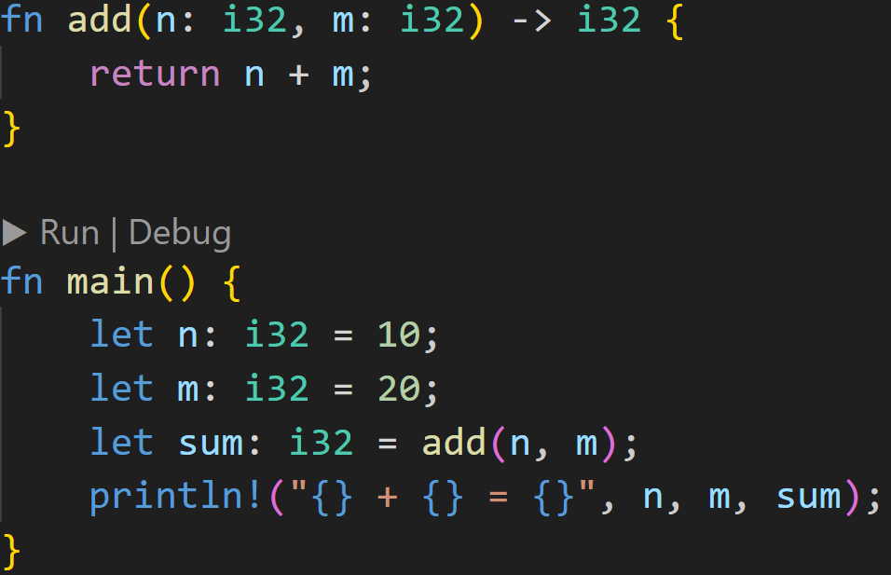
Recap
©Philippe Felix Haupt 2023

Slide 13
Recap
2 parameters of types i32
©Philippe Felix Haupt 2023

Slide 14
Recap
2 parameters of types i32
2 arguments of types i32
©Philippe Felix Haupt 2023

Slide 15
Recap
Return type i32
©Philippe Felix Haupt 2023

Slide 16
Recap
Return type i32
Returns i32
©Philippe Felix Haupt 2023

Slide 17
Recap
Return type i32
Returns i32, so we can assign to i32
©Philippe Felix Haupt 2023

Slide 18
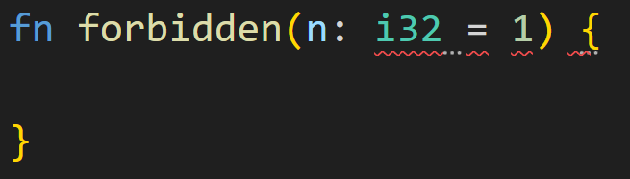
Function Extra
No default arguments in Rust
©Philippe Felix Haupt 2023

Slide 19
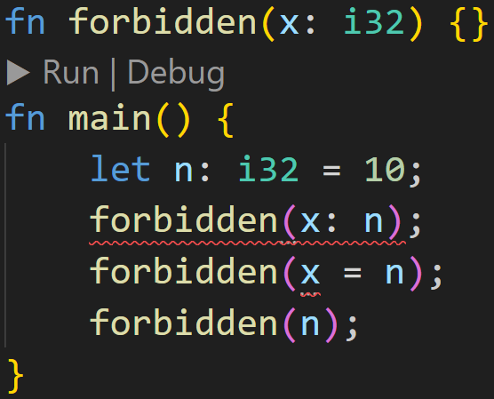
Function Extra
©Philippe Felix Haupt 2023

Slide 20
Function Extra
No named arguments
©Philippe Felix Haupt 2023

Slide 21
Function Extra
No named arguments
Can only do this
©Philippe Felix Haupt 2023

Slide 22
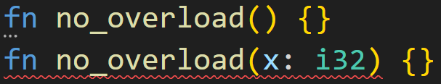
Function Extra
Rust does not support overloaded functions:
There can only ever be a single function declaration with a given name in the module
©Philippe Felix Haupt 2023

Slide 23
Structs
Now that we’re familiar with functions and some basic types, we can try to write our first real program:
©Philippe Felix Haupt 2023

Slide 24
Structs
Now that we’re familiar with functions and some basic types, we can try to write our first real program:
We want to create a console application where a ball bounces around the screen
©Philippe Felix Haupt 2023

Slide 25
Structs
Now that we’re familiar with functions and some basic types, we can try to write our first real program:
We want to create a console application where a ball bounces around the screen
Note: You can find the source code for this application in this weeks directory, in a project called `ball_app`
©Philippe Felix Haupt 2023

Slide 26
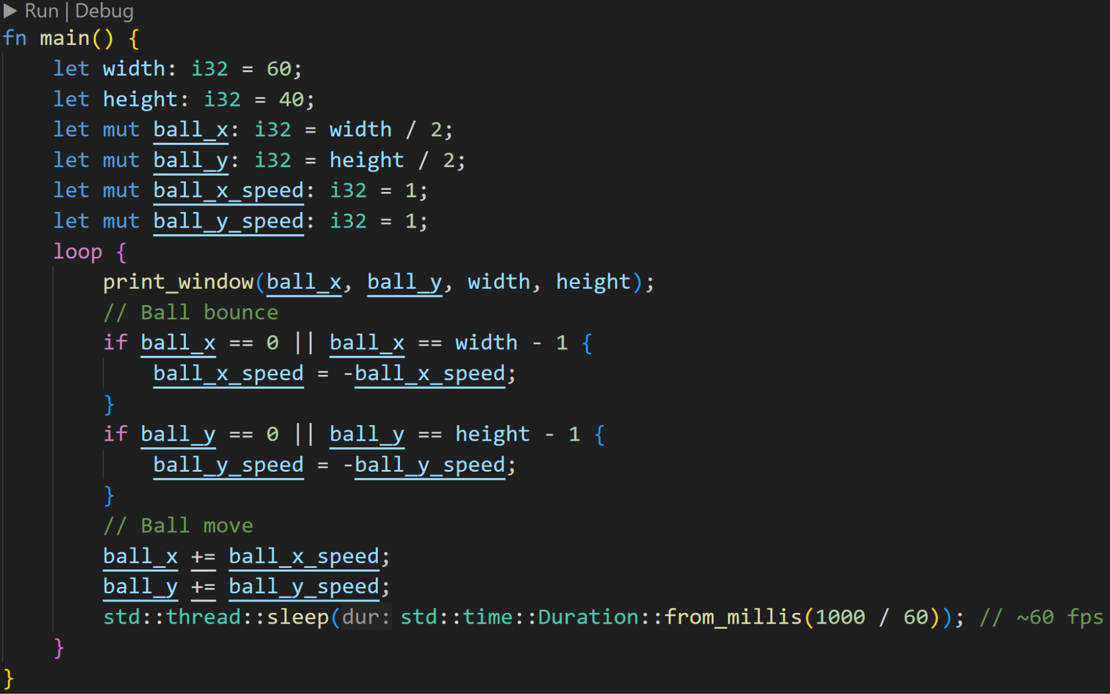
Structs
Now that we’re familiar with functions and some basic types, we can try to write our first real program:
We want to create a console application where a ball bounces around the screen
Note: You can find the source code for this application in this weeks directory, in a folder called `balls`
©Philippe Felix Haupt 2023

Slide 27
Structs
Now that we’re familiar with functions and some basic types, we can try to write our first real program:
We want to create a console application where a ball bounces around the screen
Note: You can find the source code for this application in this weeks directory, in a folder called `balls`
Basic loop, we never want to stop the application
©Philippe Felix Haupt 2023

Slide 28
Structs
Variables to store the application state, like the ball position and velocity
Now that we’re familiar with functions and some basic types, we can try to write our first real program:
We want to create a console application where a ball bounces around the screen
Note: You can find the source code for this application in this weeks directory, in a folder called `balls`
©Philippe Felix Haupt 2023

Slide 29
Structs
Variables to store the application state, like the ball position and velocity
Now that we’re familiar with functions and some basic types, we can try to write our first real program:
We want to create a console application where a ball bounces around the screen
Note: You can find the source code for this application in this weeks directory, in a folder called `balls`
Function to print the window to the console, defined above main()
©Philippe Felix Haupt 2023

Slide 30
Structs
Variables to store the application state, like the ball position and velocity
Now that we’re familiar with functions and some basic types, we can try to write our first real program:
We want to create a console application where a ball bounces around the screen
Note: You can find the source code for this application in this weeks directory, in a folder called `balls`
Function to print the window to the console, defined above main()
If we’re at the edge of the window, simulate bounce by inverting velocity
©Philippe Felix Haupt 2023

Slide 31
Structs
Variables to store the application state, like the ball position and velocity
Now that we’re familiar with functions and some basic types, we can try to write our first real program:
We want to create a console application where a ball bounces around the screen
Note: You can find the source code for this application in this weeks directory, in a folder called `balls`
Function to print the window to the console, defined above main()
If we’re at the edge of the window, simulate bounce by inverting velocity
Update position of ball
©Philippe Felix Haupt 2023

Slide 32
Structs
Variables to store the application state, like the ball position and velocity
Now that we’re familiar with functions and some basic types, we can try to write our first real program:
We want to create a console application where a ball bounces around the screen
Note: You can find the source code for this application in this weeks directory, in a folder called `balls`
Function to print the window to the console, defined above main()
If we’re at the edge of the window, simulate bounce by inverting velocity
Update position of ball
sleep() freezes the application for the given duration, so we don’t eat 100% of the CPU, here we’re simulating 60 frames per second (we draw to the console 60 times per second)
©Philippe Felix Haupt 2023

Slide 33
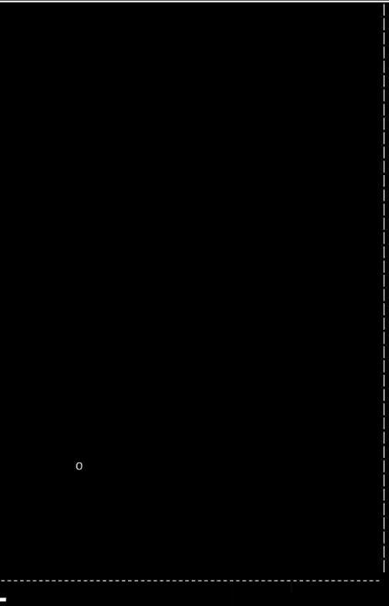
Structs
Demo:
©Philippe Felix Haupt 2023

Slide 34
Structs
Demo:
Not pretty, but it works :^)
©Philippe Felix Haupt 2023

Slide 35
Structs
Notice how there are a lot of variables dedicated to keeping track of the ball state?
©Philippe Felix Haupt 2023

Slide 36
Structs
Notice how there are a lot of variables dedicated to keeping track of the ball state?
Initialization
Modification
©Philippe Felix Haupt 2023

Slide 37
Structs
Is it possible to organize all those variables in a structured way, so we can easily generate and manage more balls?
©Philippe Felix Haupt 2023

Slide 38
Structs
Is it possible to organize all those variables in a structured way, so we can easily generate and manage more balls?
The answer is yes, we can!
Today, you’ll learn about structs, and how they make our small application more readable and extendable
©Philippe Felix Haupt 2023

Slide 39
Structs - Declaration
Structs in Rust are collections of values
©Philippe Felix Haupt 2023

Slide 40
Structs - Declaration
Structs in Rust are collections of values
We’ve seen one before: Vector!
A Vector in Rust is also a struct
Each Vector has values:
length
capacity
elements
©Philippe Felix Haupt 2023

Slide 41
Structs - Declaration
Structs in Rust are collections of values
We’ve seen one before: Vector!
Structs in Rust are declared using the keyword struct
©Philippe Felix Haupt 2023

Slide 42
Structs - Declaration
Structs in Rust are collections of values
We’ve seen one before: Vector!
Structs in Rust are declared using the keyword struct
Structs can contain any number of fields, even 0
©Philippe Felix Haupt 2023

Slide 43
Structs - Declaration
Structs in Rust are collections of values
We’ve seen one before: Vector!
Structs in Rust are declared using the keyword struct
Structs can contain any number of fields, even 0
A simple Vector has three fields:
length
capacity
elements
©Philippe Felix Haupt 2023

Slide 44
Structs - Declaration
Structs in Rust are collections of values
We’ve seen one before: Vector!
Structs in Rust are declared using the keyword struct
Structs can contain any number of fields, even 0
Each instance of a struct has its own field values
©Philippe Felix Haupt 2023

Slide 45
Structs - Declaration
Structs in Rust are collections of values
We’ve seen one before: Vector!
Structs in Rust are declared using the keyword struct
Structs can contain any number of fields, even 0
Each instance of a struct has its own field values
You access fields of a struct instance using the dot syntax
©Philippe Felix Haupt 2023

Slide 46
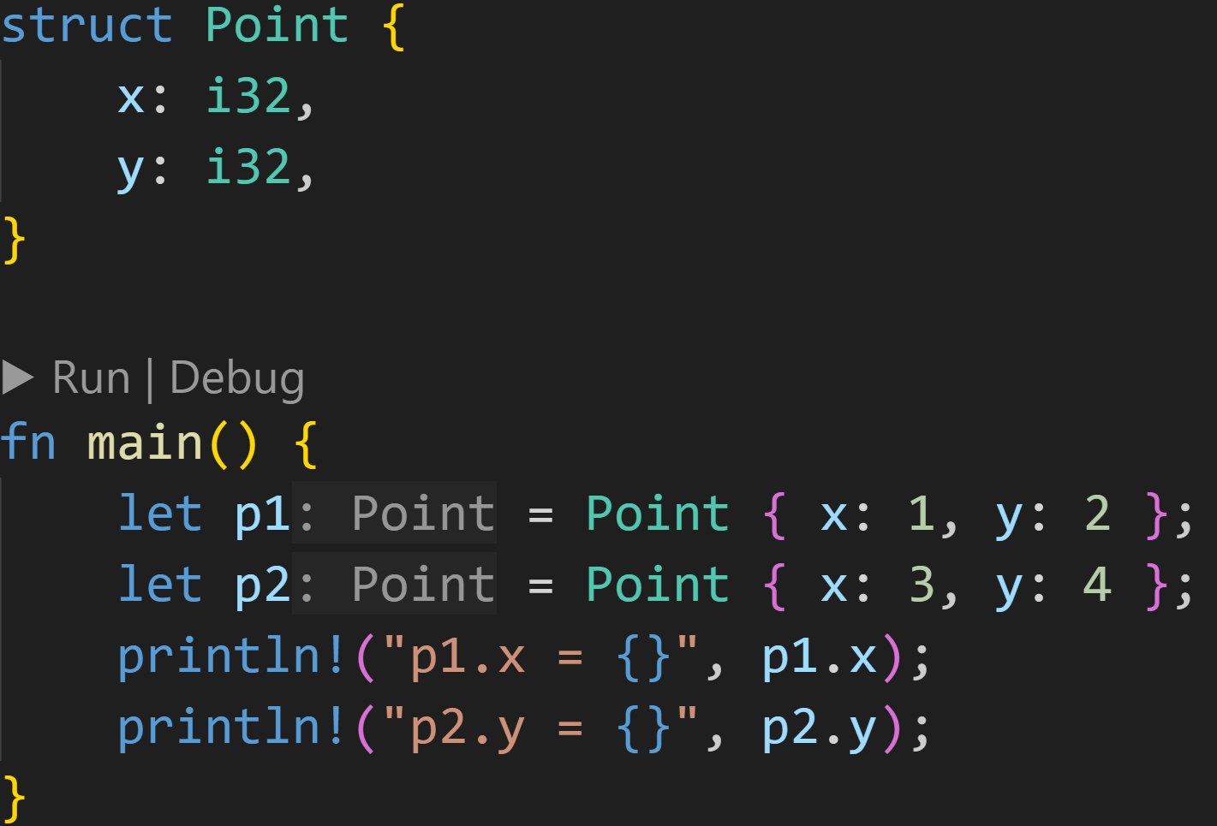
Structs - Declaration
©Philippe Felix Haupt 2023

Slide 47
Structs - Declaration
Declare struct with two fields
©Philippe Felix Haupt 2023

Slide 48
Structs - Declaration
Declare struct with two fields
Create an instance of the struct
©Philippe Felix Haupt 2023

Slide 49
Structs - Declaration
Declare struct with two fields
Create an instance of the struct
p1 and p2 are two instances of Point
©Philippe Felix Haupt 2023

Slide 50
Structs - Declaration
Declare struct with two fields
Create an instance of the struct
p1 and p2 are two instances of Point
Access field y of instance p2
©Philippe Felix Haupt 2023

Slide 51
Structs - Declaration
Structs are type definitions
©Philippe Felix Haupt 2023

Slide 52
Structs - Declaration
Structs are type definitions
By defining the struct Point, we can:
Pass instances of Point as arguments/parameters
Pass instances of Point as return values
Declare a struct with a field of type Point (With a caveat)
and much more
©Philippe Felix Haupt 2023

Slide 53
Structs - Declaration
Structs are type definitions
By defining the struct Point, we can:
Pass instances of Point as arguments/parameters
Pass instances of Point as return values
Declare a struct with a field of type Point (With a caveat)
and much more
Normal Ownership and Borrow Checker rules apply to our structs as well:
By default, struct instances are always moved
©Philippe Felix Haupt 2023

Slide 54
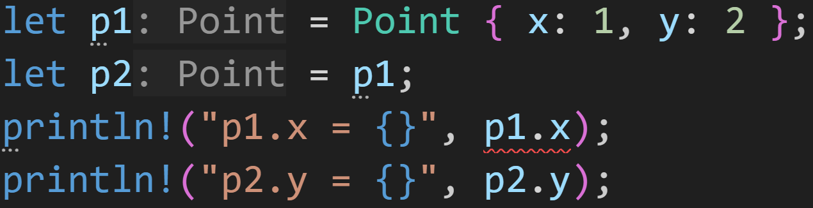
Structs - Declaration
Structs are type definitions
By defining the struct Point, we can:
Pass instances of Point as arguments/parameters
Pass instances of Point as return values
Declare a struct with a field of type Point (With a caveat)
and much more
Normal Ownership and Borrow Checker rules apply to our structs as well:
By default, struct instances are always moved
©Philippe Felix Haupt 2023

Slide 55
Structs - Declaration
Structs are type definitions
By defining the struct Point, we can:
Pass instances of Point as arguments/parameters
Pass instances of Point as return values
Declare a struct with a field of type Point (With a caveat)
and much more
Normal Ownership and Borrow Checker rules apply to our structs as well:
By default, struct instances are always moved
We know what this means :^)
©Philippe Felix Haupt 2023

Slide 56
Structs - Declaration
Structs are type definitions
By defining the struct Point, we can:
Pass instances of Point as arguments/parameters
Pass instances of Point as return values
Declare a struct with a field of type Point (With a caveat)
and much more
Normal Ownership and Borrow Checker rules apply to our structs as well:
By default, struct instances are always moved
Using traits we can tell Rust to not move the struct
©Philippe Felix Haupt 2023

Slide 57
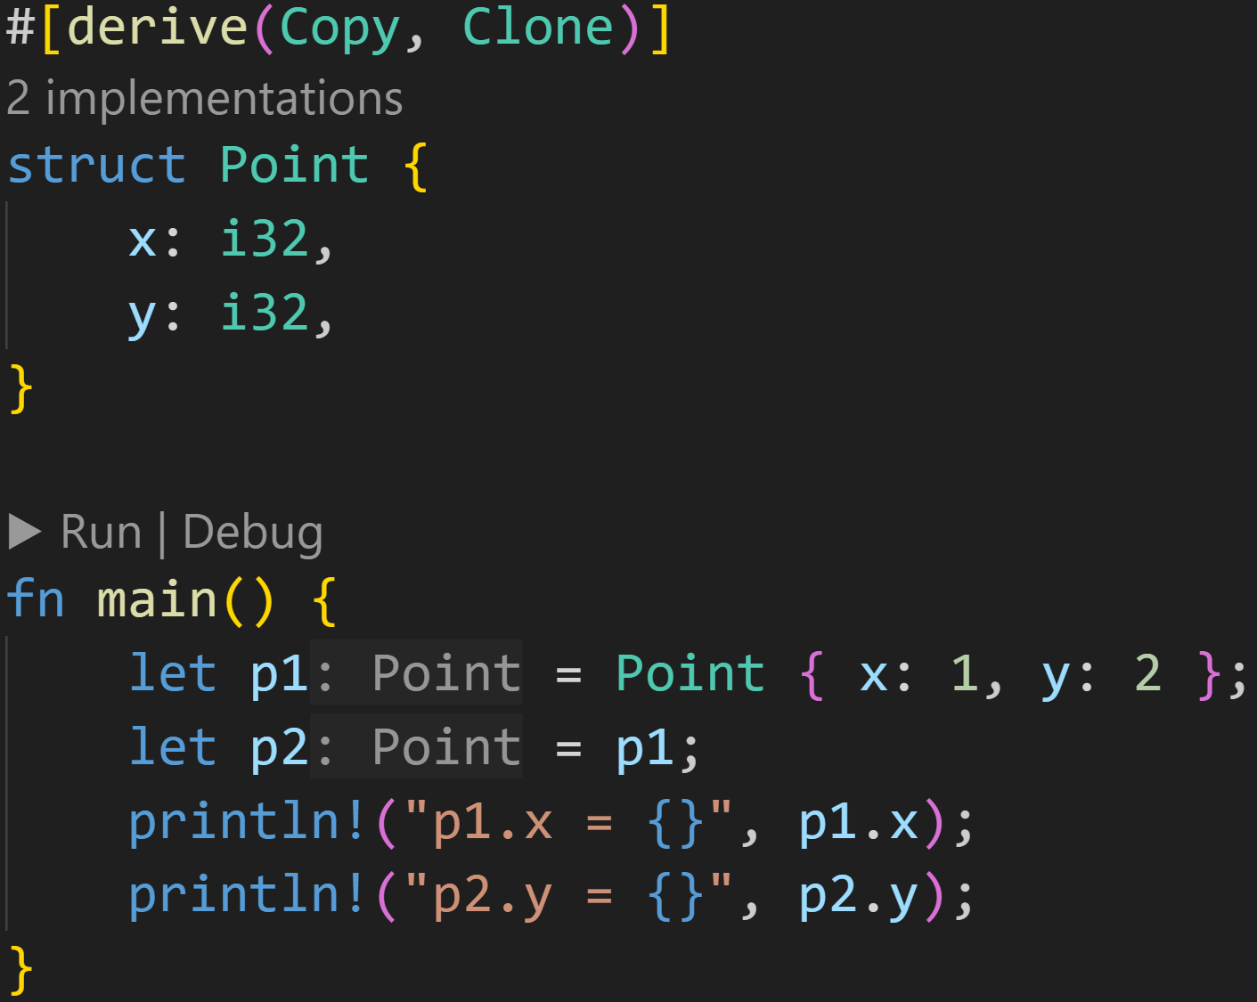
Structs - Declaration
©Philippe Felix Haupt 2023

Slide 58
Structs - Declaration
Using Rust magic, we can now copy our Points!
p1 is copied now!
©Philippe Felix Haupt 2023

Slide 59
Structs - Declaration
Using Rust magic, we can now copy our Points!
What does derive mean? What does Copy mean? What does Clone mean? → More on that later
p1 is copied now!
©Philippe Felix Haupt 2023

Slide 60
Structs - Declaration
Structs in Rust are always located on the Stack
©Philippe Felix Haupt 2023

Slide 61
Structs - Declaration
Structs in Rust are always located on the Stack
This means that the size of a struct must be known at compile time
©Philippe Felix Haupt 2023

Slide 62
Structs - Declaration
Structs in Rust are always located on the Stack
This means that the size of a struct must be known at compile time
But there’s an easy example for when this is impossible to know
©Philippe Felix Haupt 2023

Slide 63
Structs - Declaration
Structs in Rust are always located on the Stack
This means that the size of a struct must be known at compile time
But there’s an easy example for when this is impossible to know
When?
2/3
©Philippe Felix Haupt 2023

Slide 64
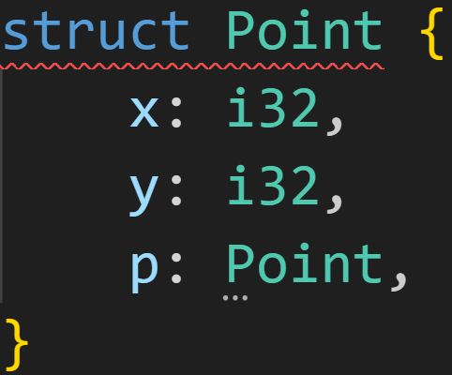
Structs - Declaration
Structs in Rust are always located on the Stack
This means that the size of a struct must be known at compile time
But there’s an easy example for when this is impossible to know
Correct, Recursion :)
©Philippe Felix Haupt 2023

Slide 65

Structs - Declaration
Structs in Rust are always located on the Stack
This means that the size of a struct must be known at compile time
But there’s an easy example for when this is impossible to know
Correct, Recursion :)
©Philippe Felix Haupt 2023

Slide 66
Structs - Declaration
Structs in Rust are always located on the Stack
This means that the size of a struct must be known at compile time
But there’s an easy example for when this is impossible to know
Correct, Recursion :)
To get the size of a struct, we simply add the sizes of all fields together, but here we don’t know the size of field `p`! Point = i32 + i32 + Point
©Philippe Felix Haupt 2023

Slide 67
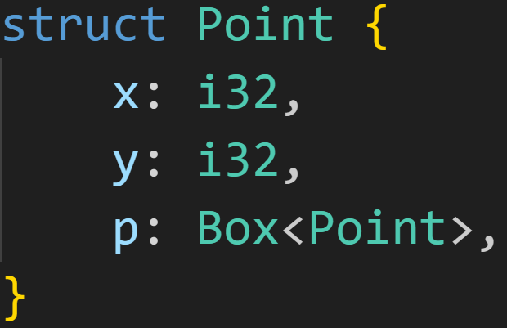
Structs - Declaration
Structs in Rust are always located on the Stack
This means that the size of a struct must be known at compile time
But there’s an easy example for when this is impossible to know
Correct, Recursion :)
There’s a solution to this problem: We break the size explosion by moving the field to the Heap:
©Philippe Felix Haupt 2023

Slide 68
Structs - Declaration
Structs in Rust are always located on the Stack
This means that the size of a struct must be known at compile time
But there’s an easy example for when this is impossible to know
Correct, Recursion :)
There’s a solution to this problem: We break the size explosion by moving the field to the Heap:
Box is a Wrapper for a Pointer to the heap
©Philippe Felix Haupt 2023

Slide 69
Structs - Declaration
Structs in Rust are always located on the Stack
This means that the size of a struct must be known at compile time
But there’s an easy example for when this is impossible to know
Correct, Recursion :)
There’s a solution to this problem: We break the size explosion by moving the field to the Heap:
3/3
How does this solve our problem?
Box is a Wrapper for a Pointer to the heap
©Philippe Felix Haupt 2023

Slide 70
Structs - Declaration
Structs in Rust are always located on the Stack
This means that the size of a struct must be known at compile time
But there’s an easy example for when this is impossible to know
Correct, Recursion :)
There’s a solution to this problem: We break the size explosion by moving the field to the Heap:
3/3
How does this solve our problem? We know the size of a Box, it’s at most 8 bytes :) It does not care about the underlying struct
Box is a Wrapper for a Pointer to the heap
©Philippe Felix Haupt 2023

Slide 71
Structs - Methods
Structs themselves are powerful, but we can go a step further, by declaring associated functions
©Philippe Felix Haupt 2023

Slide 72
Structs - Methods
Structs themselves are powerful, but we can go a step further, by declaring associated functions
Associated functions are associated with a type
We’ve seen some of those too
Vec::new() associates the function new() with the type Vec
f32::sqrt() associates the function sqrt() with the type f32
©Philippe Felix Haupt 2023

Slide 73
Structs - Methods
Structs themselves are powerful, but we can go a step further, by declaring associated functions
Associated functions are associated with a type
We’ve seen some of those too
Vec::new() associates the function new() with the type Vec
f32::sqrt() associates the function sqrt() with the type f32
Associated functions have an advantage over normal functions:
We can have multiple associated functions with the same name
Point::new() does not overlap with Vec::new(), those are two different functions
Point::new() still overlaps with Point::new(x: i32) though
©Philippe Felix Haupt 2023

Slide 74
Structs - Methods
Structs themselves are powerful, but we can go a step further, by declaring associated functions
Associated functions are associated with a type
We’ve seen some of those too
Vec::new() associates the function new() with the type Vec
f32::sqrt() associates the function sqrt() with the type f32
Associated functions have an advantage over normal functions:
We can have multiple associated functions with the same name
Point::new() does not overlap with Vec::new(), those are two different functions
Point::new() still overlaps with Point::new(x: i32) though
Associated functions can be implemented for any type using the keyword impl
©Philippe Felix Haupt 2023

Slide 75
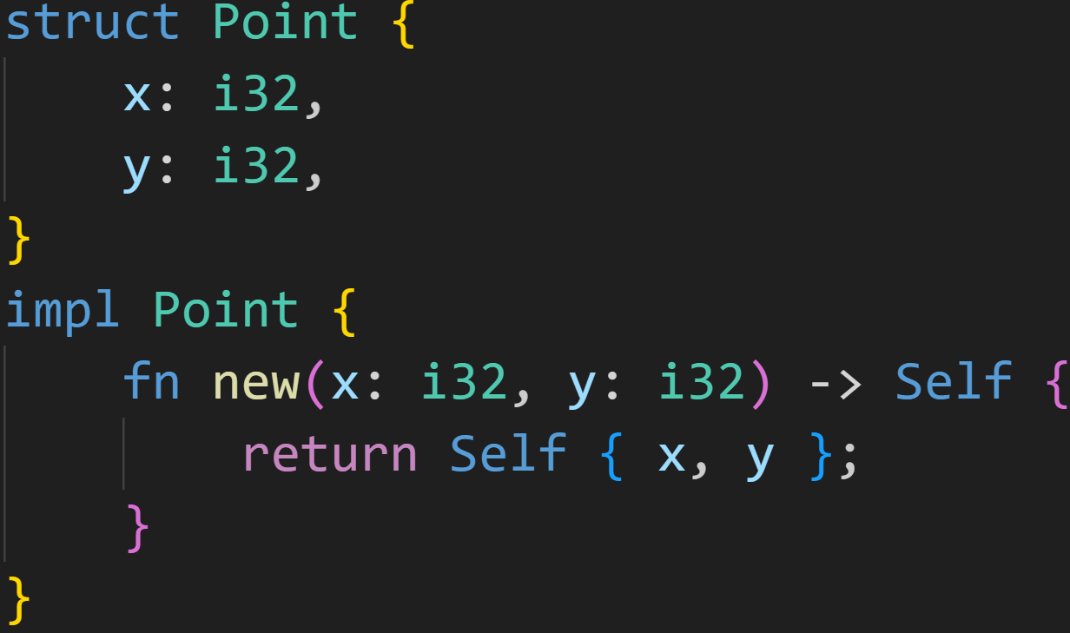
Structs - Methods
©Philippe Felix Haupt 2023

Slide 76
Structs - Methods
Any function defined in this bracket block is a function associated with Point and can be called using the syntax Point::function_name() Here, we define Point::new()
©Philippe Felix Haupt 2023

Slide 77
Structs - Methods
We don’t need to type Point everywhere, Rust has Self: Self refers to the type of the impl-block, here it’s Point
©Philippe Felix Haupt 2023

Slide 78
Structs - Methods
We don’t need to type Point everywhere, Rust has Self: Self refers to the type of the impl-block, here it’s Point
Syntax sugar for: return Point { x, y };
©Philippe Felix Haupt 2023

Slide 79
Structs - Methods
We don’t need to type Point everywhere, Rust has Self: Self refers to the type of the impl-block, here it’s Point
Syntax sugar for: return Point { x, y };
Syntax sugar for: x: x, y: y
©Philippe Felix Haupt 2023

Slide 80
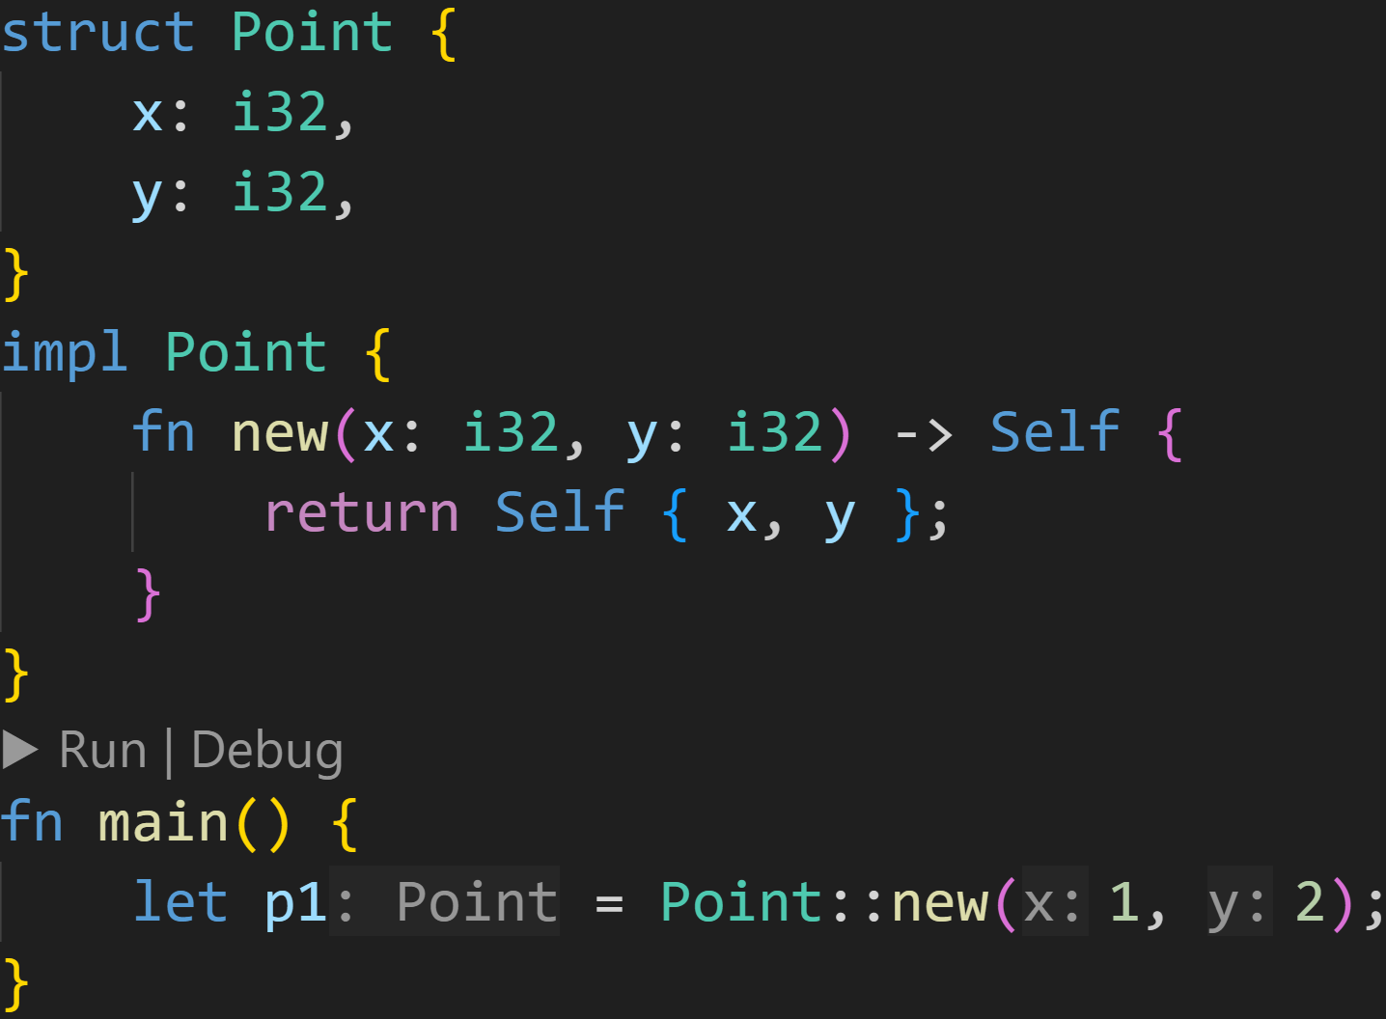
Structs - Methods
©Philippe Felix Haupt 2023

Slide 81
Structs - Methods
Because new() is an associated function, we need to specify the type before, otherwise Rust wouldn’t know which new() to call
©Philippe Felix Haupt 2023

Slide 82
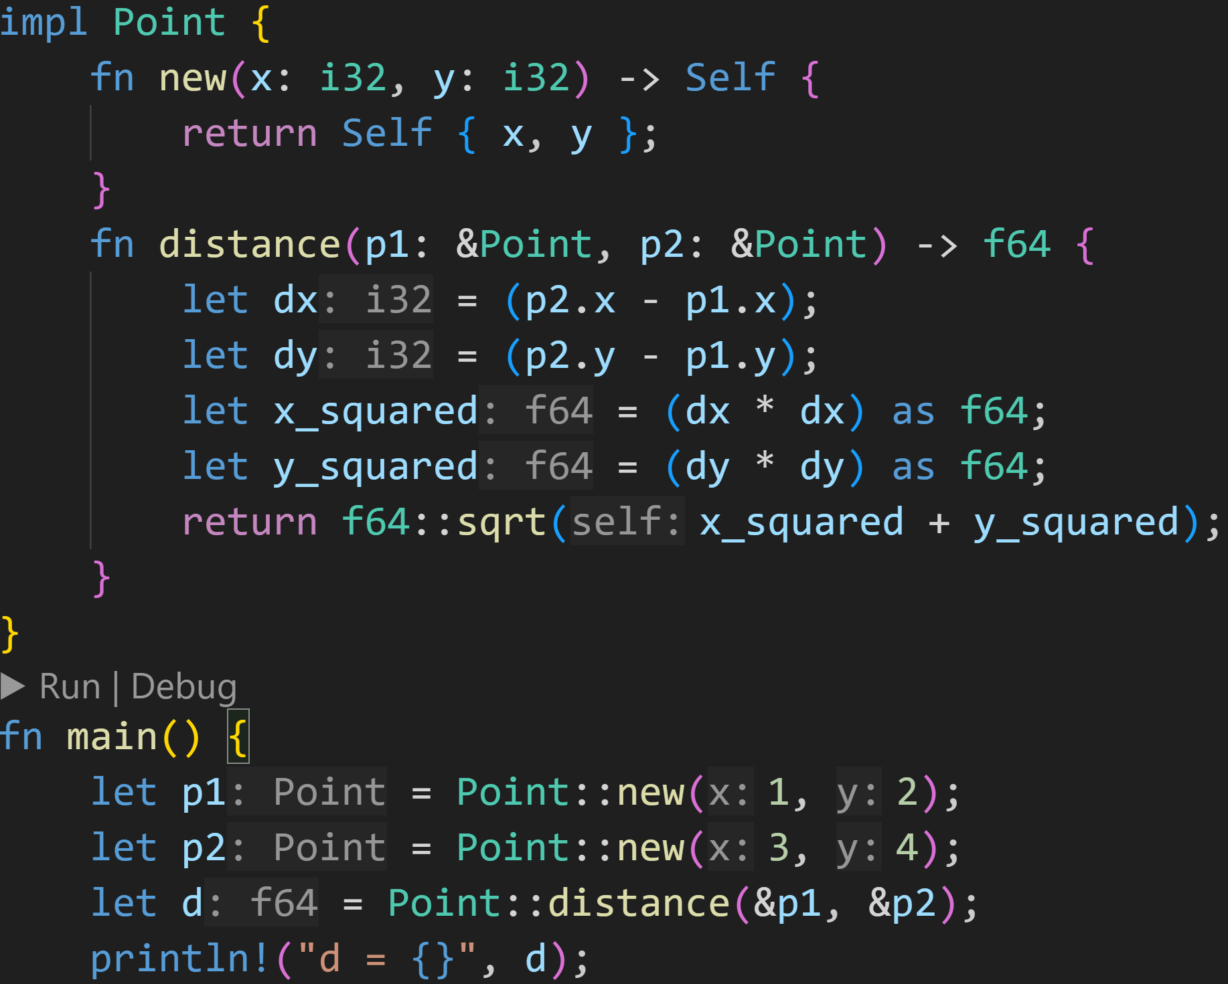
Structs - Methods
©Philippe Felix Haupt 2023

Slide 83
Structs - Methods
1/3
How many calls to associated functions are in this code snippet?
©Philippe Felix Haupt 2023

Slide 84
Structs - Methods
1/3
How many calls to associated functions are in this code snippet? Answer: 4
©Philippe Felix Haupt 2023

Slide 85
Structs - Methods
Associated function that calculates the distance between two given points
©Philippe Felix Haupt 2023

Slide 86
Structs - Methods
We’re only borrowing, we don’t need to take ownership
Associated function that calculates the distance between two given points
©Philippe Felix Haupt 2023

Slide 87
Structs - Methods
Associated function that calculates the distance between two given points
Call that function, and get the distance between p1 and p2
©Philippe Felix Haupt 2023

Slide 88
Structs - Methods
This is a lot of typing, can this be shorter?
©Philippe Felix Haupt 2023

Slide 89
Structs - Methods
There’s a special form of associated functions, called methods
©Philippe Felix Haupt 2023

Slide 90
Structs - Methods
There’s a special form of associated functions, called methods
Methods are easy to spot: The first parameter is self
©Philippe Felix Haupt 2023

Slide 91
Structs - Methods
There’s a special form of associated functions, called methods
Methods are easy to spot: The first parameter is self
Methods allow us to easily call associated functions on instances
They unlock the method call operator
©Philippe Felix Haupt 2023

Slide 92
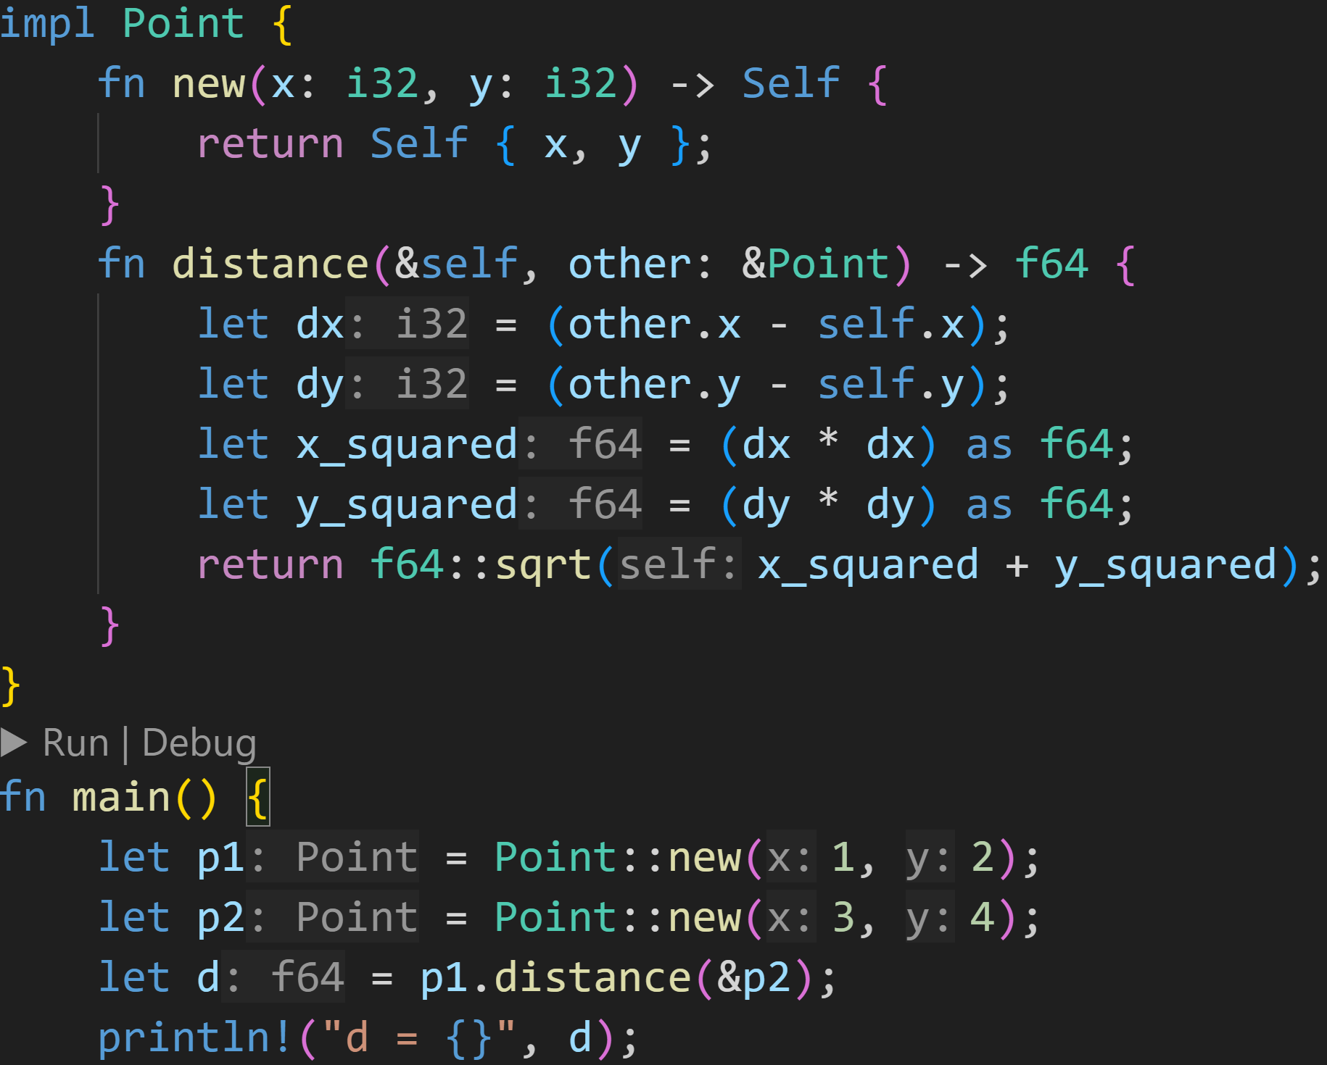
Structs - Methods
©Philippe Felix Haupt 2023

Slide 93
Structs - Methods
Method that calculates the distances between self and other
©Philippe Felix Haupt 2023

Slide 94
Structs - Methods
First parameter is simply self, without any type Rust knows what type self must have :)
Method that calculates the distances between self and other
©Philippe Felix Haupt 2023

Slide 95
Structs - Methods
First parameter is simply self, without any type Rust knows what type self must have :)
Method that calculates the distances between self and other
Method call operator: Note that we’re only passing one argument, even though we defined two parameters above! The first parameter self is implicit, here p1 is passed as self
©Philippe Felix Haupt 2023

Slide 96
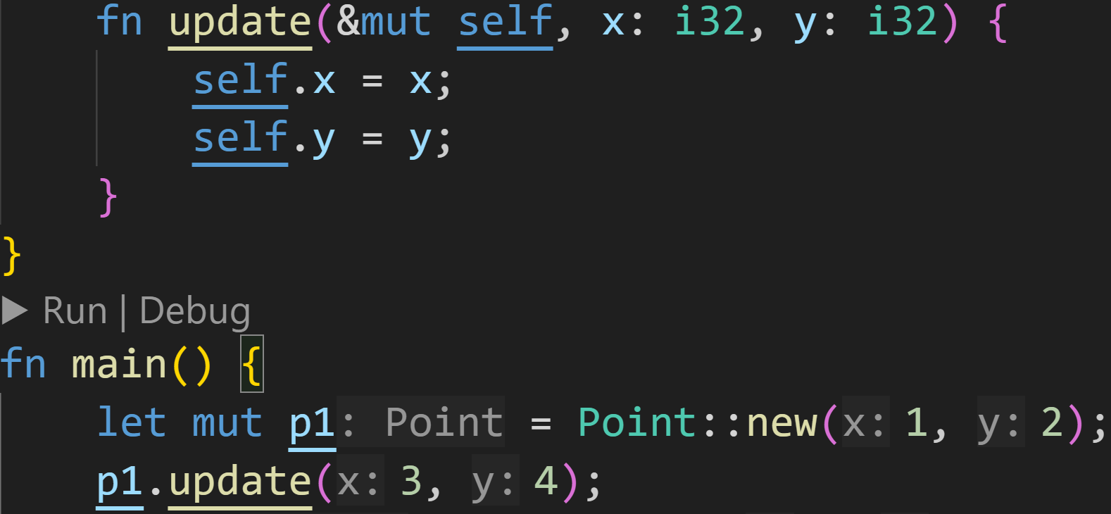
Structs - Methods
©Philippe Felix Haupt 2023

Slide 97
Structs - Methods
Of course we can also mutable borrow!
©Philippe Felix Haupt 2023

Slide 98
Structs - Methods
Of course we can also mutable borrow!
After this line, p1.x=3 and p1.y=4
©Philippe Felix Haupt 2023

Slide 99
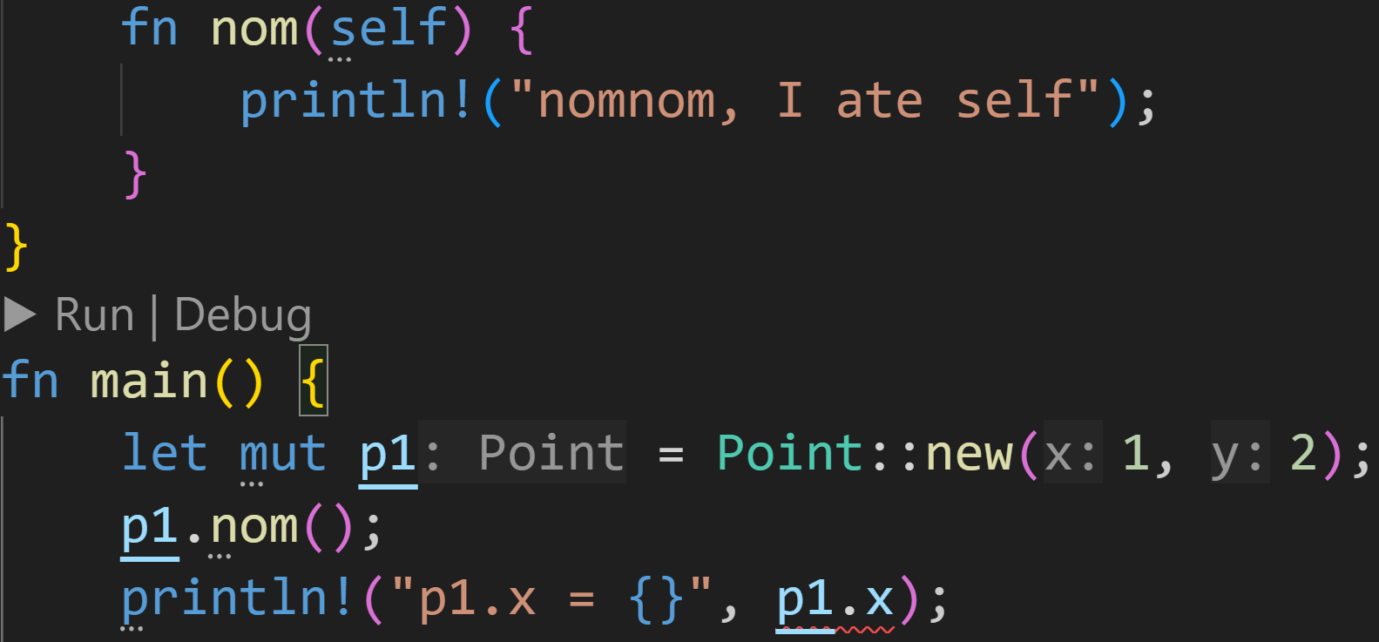
Structs - Methods
©Philippe Felix Haupt 2023

Slide 100
Structs - Methods
Method takes ownership of self, it’s dropped at the end of the pink block
©Philippe Felix Haupt 2023

Slide 101
Structs - Methods
Method takes ownership of self, it’s dropped at the end of the pink block
Can’t use p1 down here anymore!
©Philippe Felix Haupt 2023

Slide 102
Structs - Methods
Using our newfound knowledge, we can take a look at the ball application again
©Philippe Felix Haupt 2023

Slide 103
Structs - Methods
Using our newfound knowledge, we can take a look at the ball application again
We can replace our variables with a simple struct that keeps track of all the values
©Philippe Felix Haupt 2023

Slide 104
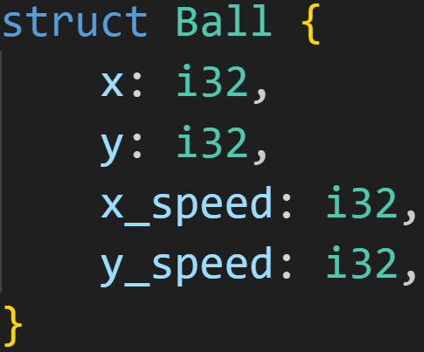
Structs - Methods
Using our newfound knowledge, we can take a look at the ball application again
We can replace our variables with a simple struct that keeps track of all the values
©Philippe Felix Haupt 2023

Slide 105
Structs - Methods
Then, we can implement some methods for the Ball struct
©Philippe Felix Haupt 2023

Slide 106
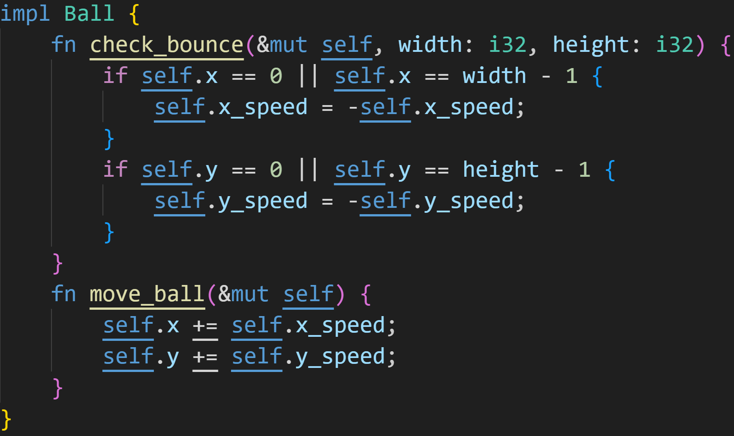
Structs - Methods
Then, we can implement some methods for the Ball struct
©Philippe Felix Haupt 2023

Slide 107
Structs - Methods
Then, we can implement some methods for the Ball struct
Putting ball in the name is kind of redundant, but move is a built in keyword and is reserved :^)
©Philippe Felix Haupt 2023

Slide 108
Structs - Methods
Finally, we can update our main function!
©Philippe Felix Haupt 2023

Slide 109
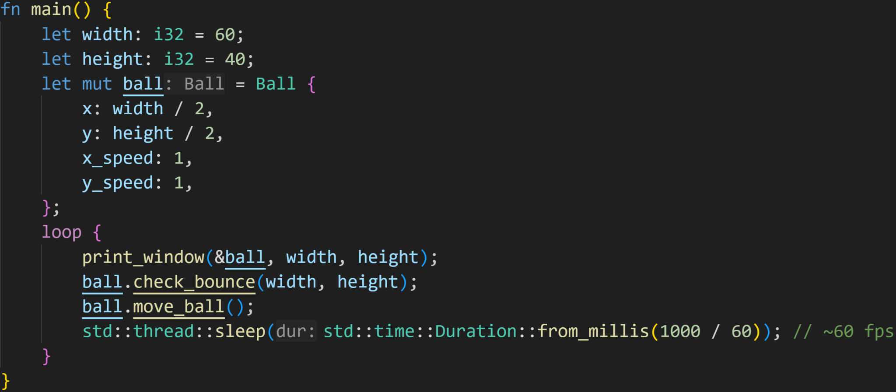
Structs - Methods
Finally, we can update our main function!
©Philippe Felix Haupt 2023

Slide 110
Structs - Methods
Finally, we can update our main function!
Initialize the instance
©Philippe Felix Haupt 2023

Slide 111
Structs - Methods
Finally, we can update our main function!
Initialize the instance
Call some methods
©Philippe Felix Haupt 2023

Slide 112
Structs - Methods
Now that we’ve switched to a struct, we can easily extend our application by adding more balls!
©Philippe Felix Haupt 2023

Slide 113
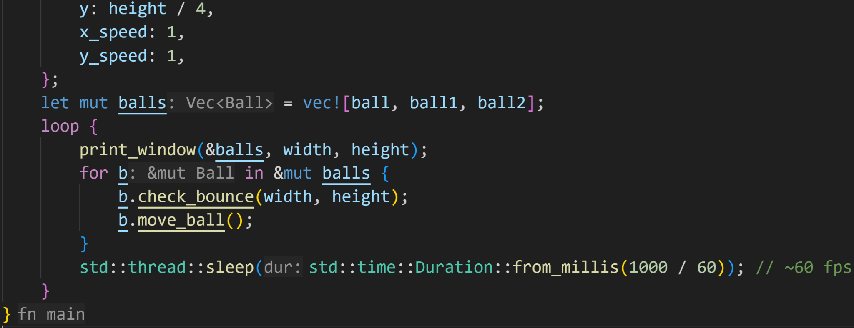
Structs - Methods
Now that we’ve switched to a struct, we can easily extend our application by adding more balls!
©Philippe Felix Haupt 2023

Slide 114
Structs - Methods
Now that we’ve switched to a struct, we can easily extend our application by adding more balls!
Declare balls above
©Philippe Felix Haupt 2023

Slide 115
Structs - Methods
Now that we’ve switched to a struct, we can easily extend our application by adding more balls!
Define list of balls
©Philippe Felix Haupt 2023

Slide 116
Structs - Methods
Now that we’ve switched to a struct, we can easily extend our application by adding more balls!
Our logic doesn’t change, except that we’re now iterating over a list of balls :)
©Philippe Felix Haupt 2023

Slide 117

Structs - Methods
Demo:
©Philippe Felix Haupt 2023

Slide 118
Intermission - Exercise
Time for exercises!
©Philippe Felix Haupt 2023

Slide 119
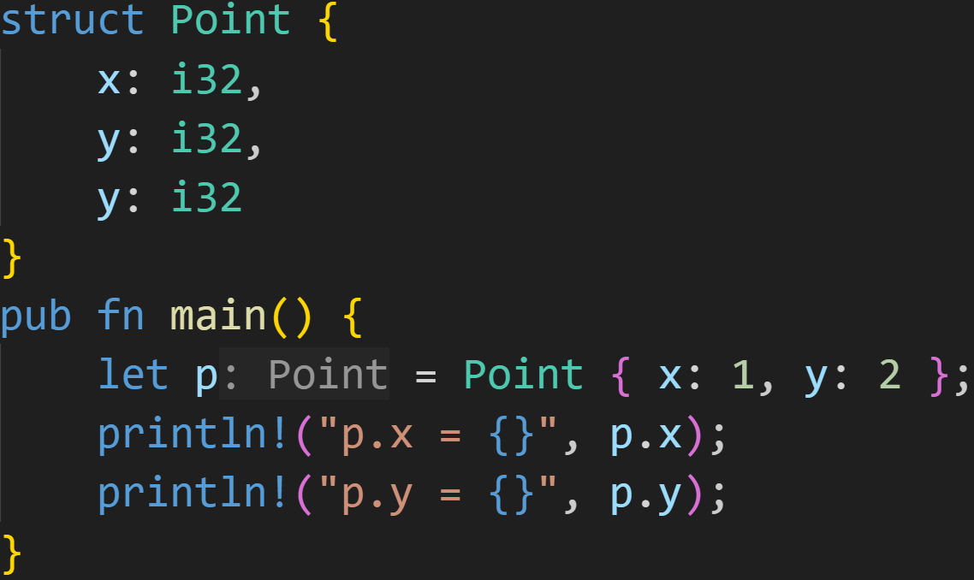
Intermission - Exercise
1/3
©Philippe Felix Haupt 2023

Slide 120
Intermission - Exercise
1/3
Does this code compile?
If yes, what does it print?
©Philippe Felix Haupt 2023

Slide 121
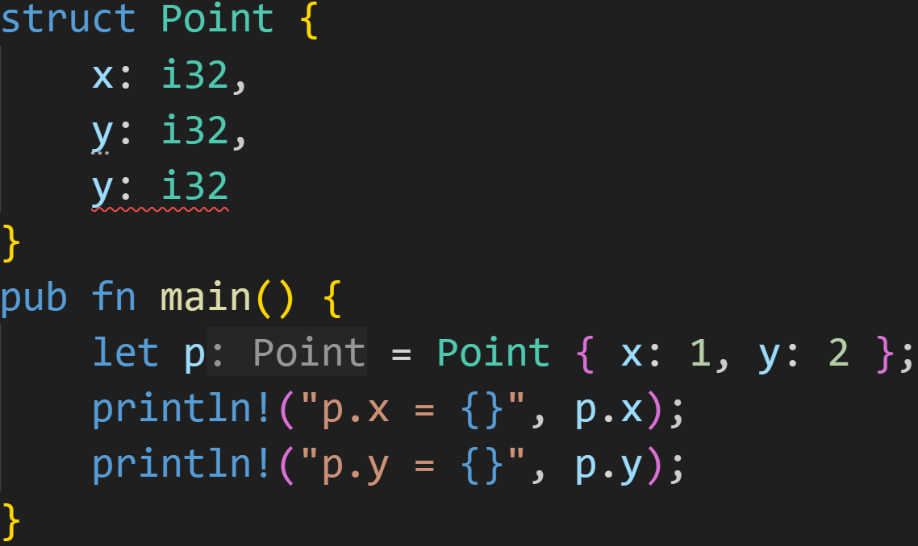
Intermission - Exercise
1/3
Does this code compile?
If yes, what does it print?
Nope, fields must have unique names :)
©Philippe Felix Haupt 2023

Slide 122
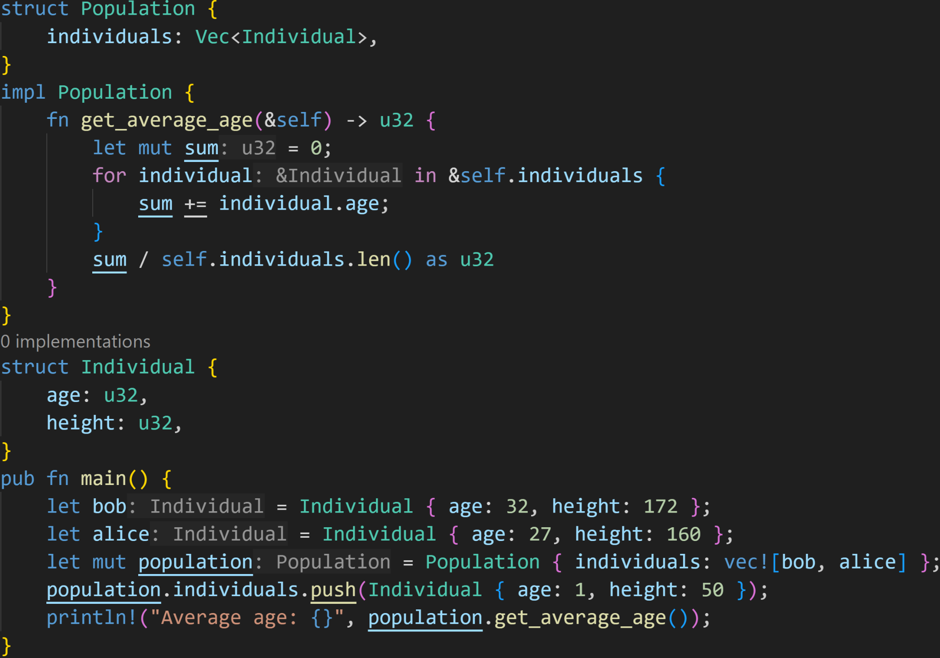
Intermission - Exercise
2/3
©Philippe Felix Haupt 2023

Slide 123
Intermission - Exercise
2/3
Does this code compile?
If yes, what does it print?
©Philippe Felix Haupt 2023

Slide 124
Intermission - Exercise
2/3
Does this code compile?
If yes, what does it print?
It does compile! This code is valid!
©Philippe Felix Haupt 2023

Slide 125
Intermission - Exercise
2/3
Does this code compile?
If yes, what does it print?
It does compile! This code is valid!
You can omit the return keyword if the return value is the last expression in a function! If you do that, you must also omit the semicolon.
©Philippe Felix Haupt 2023

Slide 126
Intermission - Exercise
2/3
Does this code compile?
If yes, what does it print?
It does compile! This code is valid!
After the marked location, there are 3 individuals in the population: - Bob, aged 32 - Alice, aged 27 - Baby, aged 1
©Philippe Felix Haupt 2023

Slide 127

Intermission - Exercise
2/3
Does this code compile?
If yes, what does it print?
It does compile! This code is valid!
After the marked location, there are 3 individuals in the population: - Bob, aged 32 - Alice, aged 27 - Baby, aged 1 The average age is 32+27+1=60/3=20 :)
©Philippe Felix Haupt 2023

Slide 128
Intermission - Exercise
3/3
Do you see any potential problems with this code snippet?
©Philippe Felix Haupt 2023

Slide 129
Intermission - Exercise
3/3
Do you see any potential problems with this code snippet?
if the population is empty, we divide by 0
©Philippe Felix Haupt 2023

Slide 130
Intermission - Exercise
3/3
Do you see any potential problems with this code snippet?
Not using an associated function means we could set inhuman ages and heights
©Philippe Felix Haupt 2023

Slide 131
Intermission - Exercise
3/3
Do you see any potential problems with this code snippet?
We could add the same individual multiple times
©Philippe Felix Haupt 2023

Slide 132
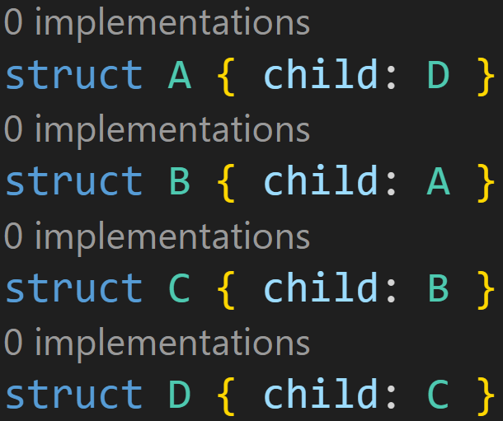
Intermission - Exercise
1/3
©Philippe Felix Haupt 2023

Slide 133
Intermission - Exercise
1/3
Does this work?
©Philippe Felix Haupt 2023

Slide 134
Intermission - Exercise
1/3
Does this work?
Size of A = Size of D
©Philippe Felix Haupt 2023

Slide 135
Intermission - Exercise
1/3
Does this work?
Size of A = Size of D Size of B = Size of A = Size of D
©Philippe Felix Haupt 2023

Slide 136
Intermission - Exercise
1/3
Does this work?
Size of A = Size of D Size of B = Size of A = Size of D Size of C = Size of B = Size of A = Size of D
©Philippe Felix Haupt 2023

Slide 137
Intermission - Exercise
1/3
Does this work?
Size of A = Size of D Size of B = Size of A = Size of D Size of C = Size of B = Size of A = Size of D Size of D = Size of C = Size of B = Size of C = Size of D
©Philippe Felix Haupt 2023

Slide 138
Intermission - Exercise
1/3
Does this work?
Size of A = Size of D Size of B = Size of A = Size of D Size of C = Size of B = Size of A = Size of D Size of D = Size of C = Size of B = Size of C = Size of D To calculate the size of D, we need the size of D! Recursive! Infinite!
©Philippe Felix Haupt 2023

Slide 139

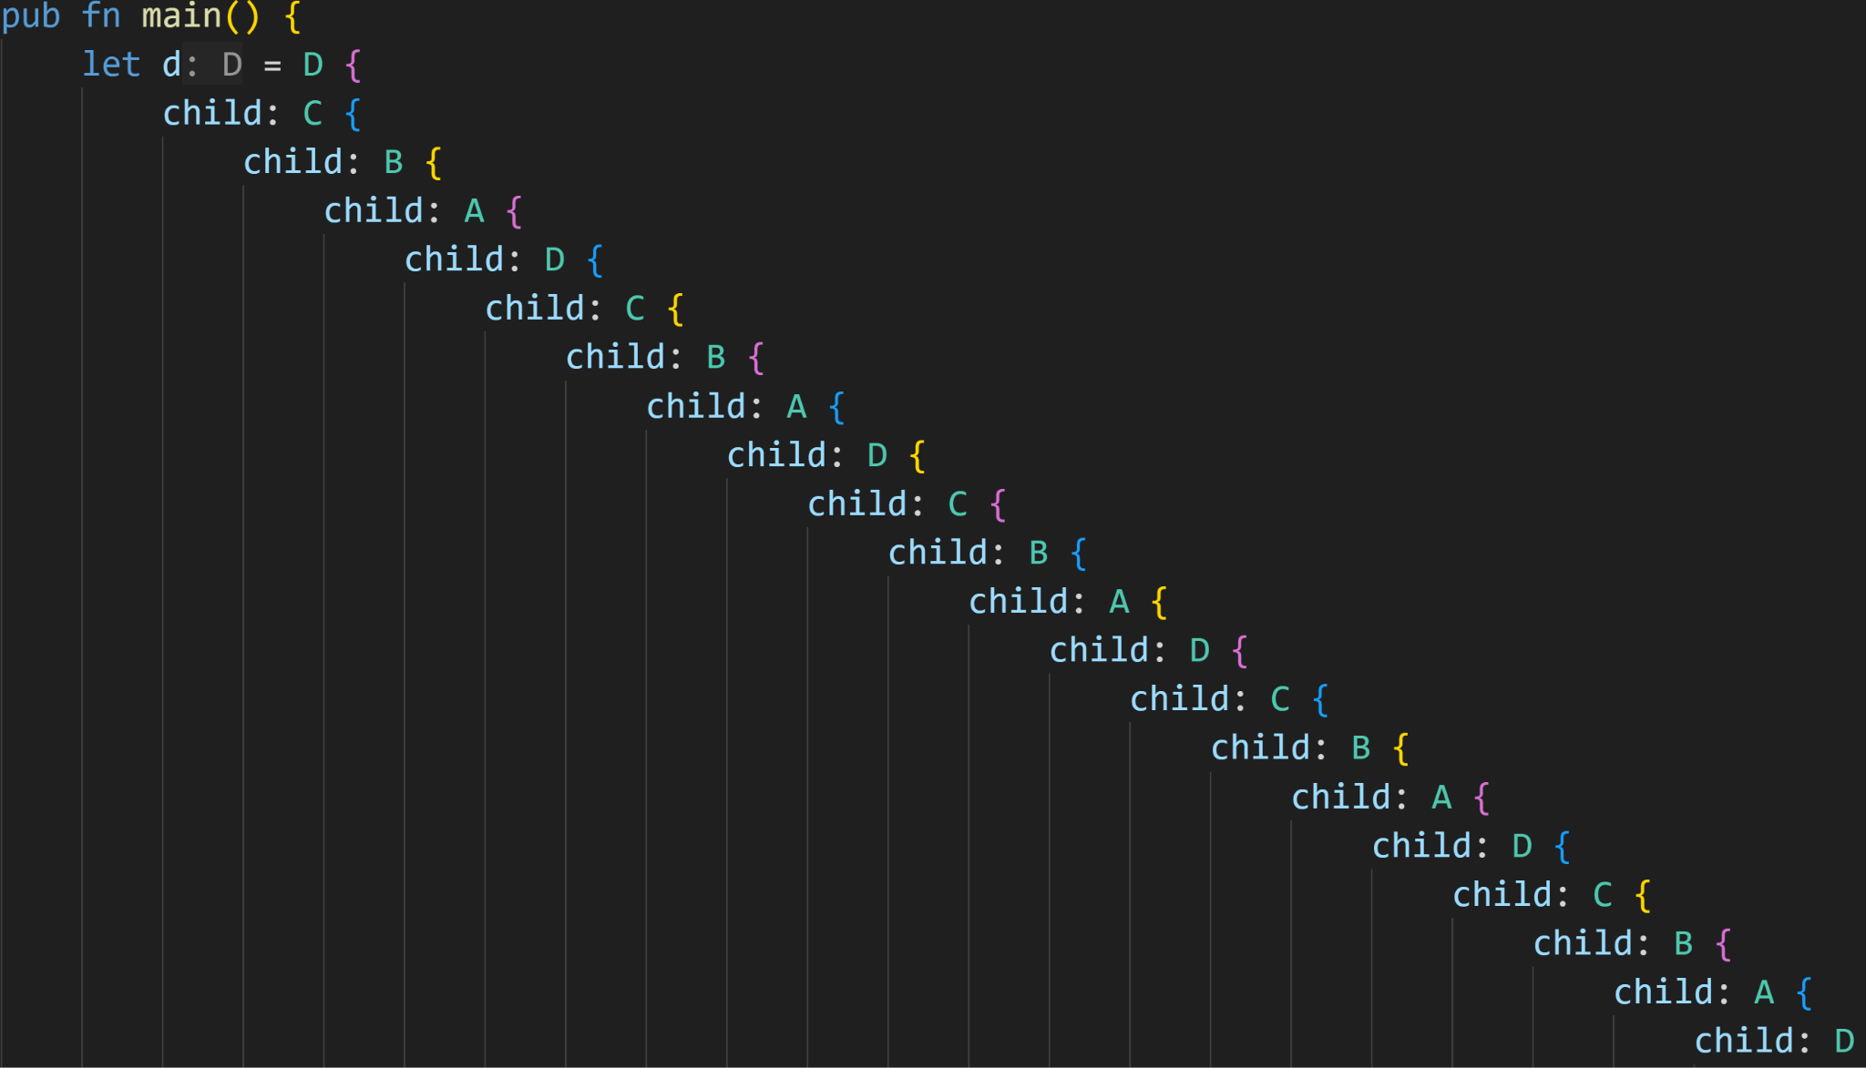
Intermission - Exercise
yeah…
©Philippe Felix Haupt 2023

Slide 140
Next time
Traits
Generic Structs
Result<T, E>
Option<T>
©Philippe Felix Haupt 2023

